Slide 1



Workplace Project Breaking Down Silos: Developing a Knowledge Sharing Platform for Internal Business
Callum White – N0897675
Notes:
Hello and welcome to my presentation about my workplace project.

Slide 2




Introduction
Layout:
Benefits of knowledge sharing platform
What’s currently in the market?
Key features and functionalities
Project scope
Project timeline
Steps to implementation
Results of the platform
Project conclusion
Notes:
Welcome, everyone, to today's presentation on developing a knowledge sharing platform for internal business. In today's fast-paced and rapidly changing business environment, it's more important than ever to break down silos and promote collaboration across teams and departments. By doing so, we can leverage the diverse skills, knowledge, and experience of our employees to drive innovation, solve complex problems, and achieve our business goals.
A knowledge sharing platform can be a powerful tool to facilitate this collaboration and promote the free flow of information and ideas across our organization. In this presentation, we will explore the benefits of developing a knowledge sharing platform, the key features and functionalities to consider, and the steps involved in implementing such a platform. We will also discuss some best practices and lessons learned from other organizations that have successfully implemented knowledge sharing platforms.
Thank you for joining us today, and we hope you find this presentation informative and valuable.

Slide 3

MHR
MHR is a leading HR & Payroll service provider who strives for continuous evolution of its product, which requires mass research be shared across the business.

Slide 4

Silos and ad-hoc sharing methods are causing issues within the business
Notes:
Our business has separate departments that work in silos, leading to communication barriers and duplication of effort.
Departments often rely on ad-hoc sharing methods like email and messaging, which are informal and can result in useful findings being excluded from certain teams.
This lack of collaboration and information sharing can result in missed opportunities, slower decision-making, and decreased innovation.
Developing a knowledge sharing platform can help us break down these silos and promote better collaboration, allowing us to leverage the diverse skills and expertise of our employees to drive innovation and achieve our business goals.
The size of MHR makes operations difficult - it's not so small that everyone knows each other but not large enough to work in individual departments/ entities successfully. This leads to projects occurring which could be beneficial to others work but they have no sight that it is happening.
The Product Design team and the Service Desk team were independently reviewing the process of sharing knowledge articles with customers to ensure consistent content. The projects were being conducted simultaneously but without knowledge of each other. Fortunately, the teams realized the overlap and joined forces, but this collaboration could have been identified earlier if a knowledge sharing platform had been in place.

Slide 5
Opportunity Revolutionizing Knowledge Sharing at MHR
Reduce duplication of effort
Increase collaboration and sharing of knowledge between departments
Stimulate idea generation and break down silos
Notes:
MHR as a leading HR service provider
Need for continuous product evolution and knowledge sharing across the business
Existing silos causing harm to company culture and decreasing efficiency
Opportunity to introduce a revolutionary way to share knowledge between departments
Immediate benefits: reduced duplication of effort
Long-term benefits: increased collaboration, knowledge sharing, and idea generation between departments, leading to reduced silos

Slide 6
Knowledge Sharing Platform for Collaborative Research
Enables real-time communication and knowledge sharing among departments
Reduces duplication of effort and exclusion of departments from useful findings
Departments involved: Product Design, UX, Research, Marketing
Items shared: links, papers, books, videos, summaries, analysis
Current ad-hoc sharing methods: email, Teams, SharePoint, OneDrive, People First communities, Miro
Notes:
Enabling real-time communication and knowledge sharing among departments can help to break down silos and promote better collaboration, leading to increased innovation and efficiency.
A knowledge sharing platform can reduce duplication of effort and help to ensure that all departments have access to useful findings, regardless of their level of involvement in the original research or discovery.
Several departments are involved in the knowledge sharing process, including Product Design, UX, Research, and Marketing, highlighting the cross-functional nature of this initiative.
The types of items shared through the knowledge sharing platform include links, papers, books, videos, summaries, and analysis, representing a diverse range of knowledge sources and formats.
Current ad-hoc sharing methods like email, Teams, SharePoint, OneDrive, People First communities, and Miro can be helpful, but they are not ideal for ensuring that all departments have access to the same information in a timely and efficient manner. A knowledge sharing platform can help to streamline this process and ensure that knowledge is shared more equitably and effectively.

Slide 7


Systems study

Slide 8
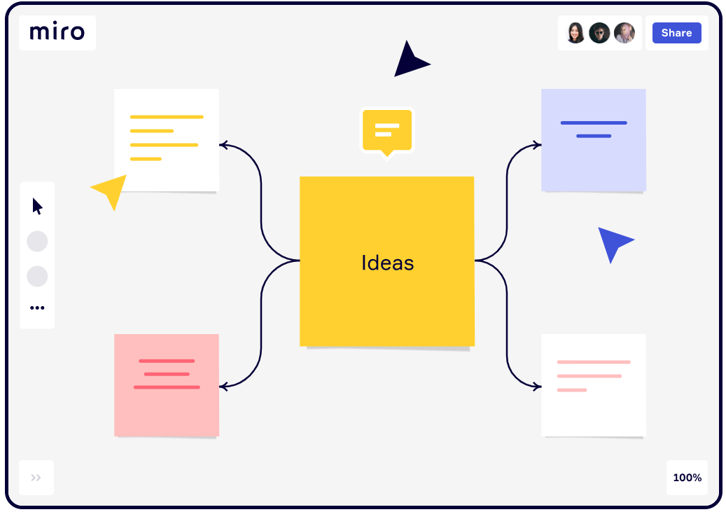
Miro board
Collaborative Digital Whiteboard
Simple to Use
Key Features:
Object arrangement
Note-making capabilities
Online chat and embedded videocalls
Facilitates seamless collaboration and communication.
(Innovation training (2021))

Slide 9
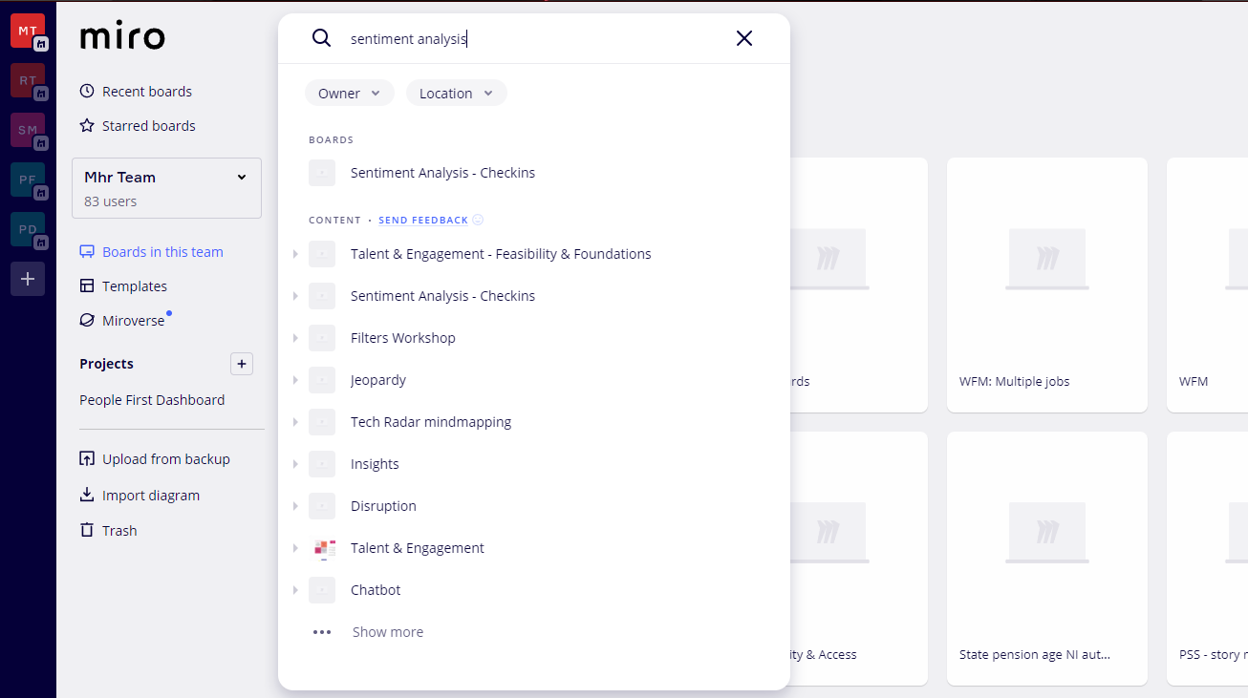
Miro board limitations
Unmanaged boards can become unwieldy
Limited structures or templates for content
Difficulties in returning to existing boards
Challenges in analysing and reporting on knowledge content
Lack of comprehensive searching capabilities within board content
Manual navigation through multiple boards to find desired information
Time-consuming and inefficient process for accessing content

Slide 10

Live demo of Miro board
Live demo of Miro board within MHR

Slide 11
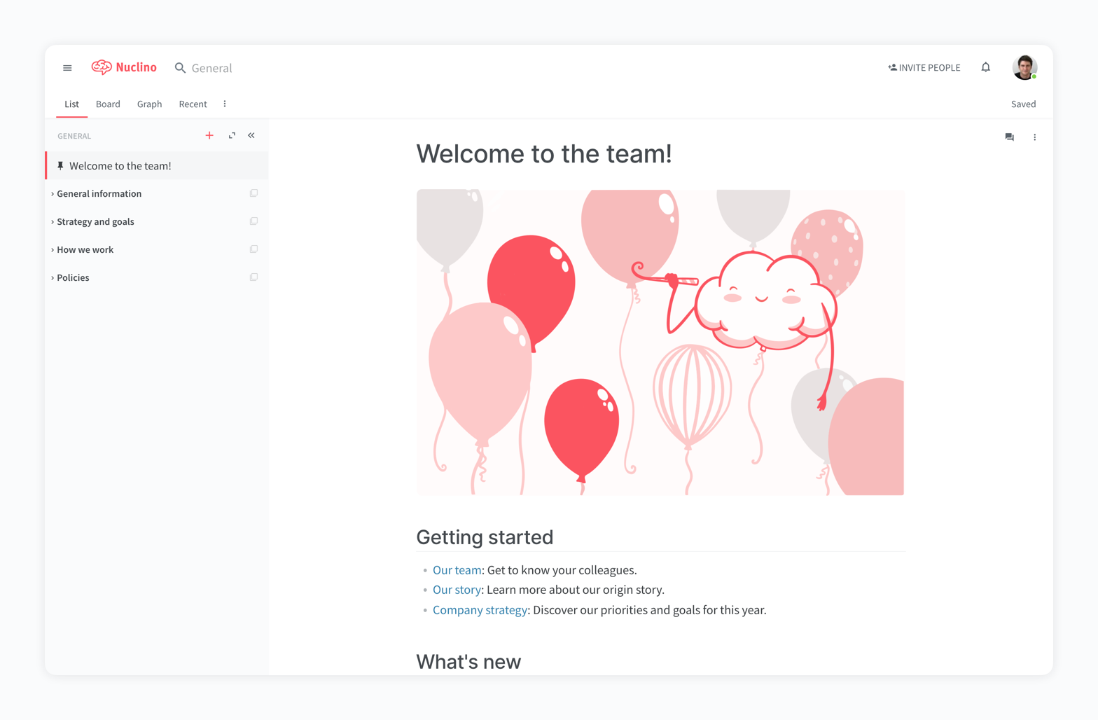
Nuclino
Real-time document sharing and editing
Knowledge management and collaboration platform
Effective search function for rapid and relevant results
Highlighted phrases in search results for easier information retrieval
Simplifies the process of locating desired information
(Marketing tools you can use 2022 (2022))

Slide 12
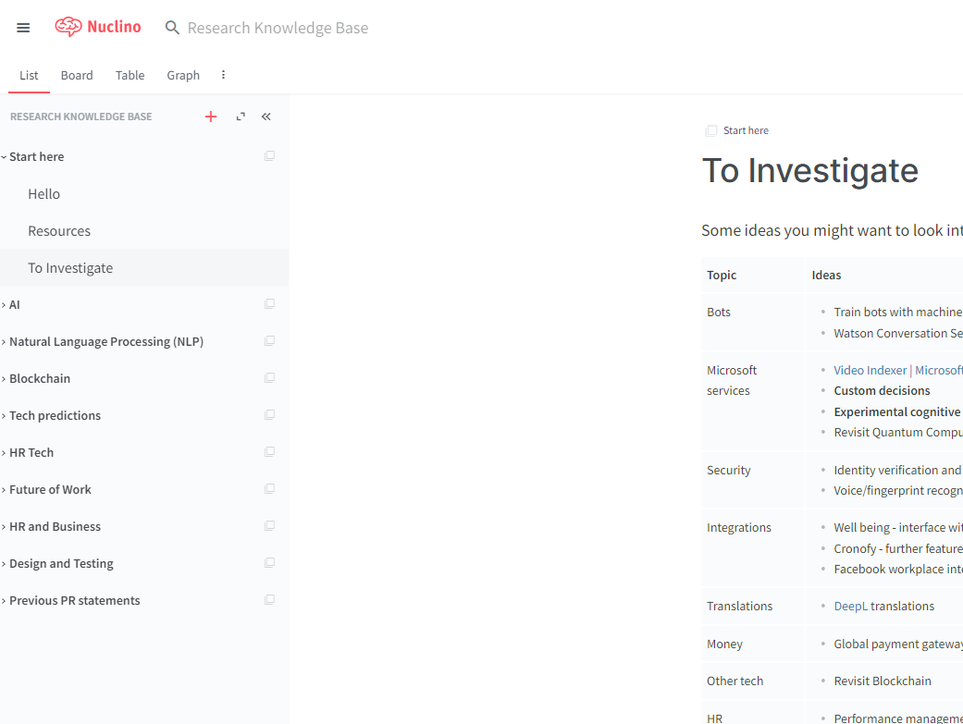
Nuclino limitations
External infrastructure:
Operates outside traditional business infrastructure
Raises concerns about sharing internal and confidential content
Poses data privacy and security risks
Pricing structure:
£4.00 per user per month
Can be a significant constraint, especially for company-wide implementation
Costs can quickly accumulate, impacting budget and accessibility
Impact on collaboration and knowledge sharing:
High implementation costs may limit access for all employees
Hinders internal communication and restricts access for teams and departments

Slide 13
Live demo of Nuclino
Live demo of Nuclino within MHR

Slide 14
Results of analysis
Miro:
Potential for becoming unwieldy and difficult to navigate without proper management
Nuclino:
Operates outside the traditional business infrastructure, raising data privacy and security concerns
Considerations:
Understanding these limitations is crucial in selecting the most suitable platform for knowledge management and collaboration needs.
Notes:
Analysis of Limitations:
Both Miro and Nuclino have certain limitations that need to be considered when evaluating them for knowledge management and collaboration purposes.
Miro:
Potential for becoming unwieldy and difficult to navigate without proper management.
Limited structures and templates for organizing content, which may not align with desired knowledge resource management.
Lack of advanced search capabilities within the board's content, leading to time-consuming and inefficient manual navigation through multiple boards.
Nuclino:
Operates outside the traditional business infrastructure, raising concerns about data privacy and security.
Pricing structure at £4.00 per user per month can be a constraint, particularly for company-wide implementation.
High implementation costs may limit access for all employees, hindering collaboration and knowledge sharing.
Both platforms have their limitations, but they differ in terms of the nature of their constraints. Miro's limitations primarily relate to board management and content organization, while Nuclino's limitations revolve around external infrastructure and pricing considerations. Understanding these limitations is crucial in making an informed decision about which platform aligns best with the organization's needs and requirements.

Slide 15
Gap: Enhancing Search Capabilities in Knowledge Repositories
Existing solutions fall short in providing effective search capabilities for knowledge repositories.
Graph databases enable complex relationships between data points, improving relevance in search results.
Tagging techniques allow for granular categorisation of information, enhancing search outcomes.
Incorporating graph databases and tagging in knowledge-sharing platforms presents a market opportunity.
These platforms can enhance knowledge management and decision-making processes

Slide 16
Opportunity for Internal Knowledge-Sharing Platform
Demand for a user-friendly knowledge-sharing platform incorporating graph databases and tagging
Benefits of graph databases and tagging for efficient knowledge management
Improved accuracy and relevance of search results
Quick access to required information
Notes:
This new system will be built inhouse, allowing for controlled outcomes of the solution’s requirements and features. This will also enable cohesive services for employees to use and provide a cloud application allowing employees to manage, tag, and search for content.

Slide 17

Challenges
People don’t share new knowledge: The repository needs to be added to regularly to ensure knowledge doesn’t stay in personal notes, OneDrive documents or within teams, therefore it needs to be accessible and easy to use.
People can’t find knowledge: The tool needs to have a good mechanism for searching so that discoverability of current knowledge is easy.
Knowledge needs to stay in-house: The tool needs to have secure access for MHR internal employees only (e.g. use of single sign on).
People will want the solution to fulfil other requirements: When creating the solution, ensure that it doesn’t try to fulfil too wide a scope – first and foremost it is an easy-to-use repository of knowledge for MHR.
Notes:
People don’t share new knowledge: The repository needs to be added to regularly to ensure knowledge doesn’t stay in personal notes, OneDrive documents or within teams, therefore it needs to be accessible and easy to use.
People can’t find knowledge: The tool needs to have a good mechanism for searching so that discoverability of current knowledge is easy.
Knowledge needs to stay in-house: The tool needs to have secure access for MHR internal employees only (e.g. use of single sign on).
People will want the solution to fulfil other requirements: When creating the solution, ensure that it doesn’t try to fulfil too wide a scope – first and foremost it is an easy-to-use repository of knowledge for MHR.

Slide 18
Professional, Ethical, Legal, and Social Issues
Professional Issues:
Integrating BCS Code of Conduct
Confidentiality and data privacy
Compliance with industry regulations
User accountability and responsibility
Ethical Issues:
Preventing Unethical Practices
Commenting for Relative Feed (Gamification)
Plagiarism
Legal Issues:
Licensing
Data Ownership
Source Control
Social Issues:
Free Text Content and Content Sharing
Notes:
Slide: Professional, Ethical, Legal, and Social Issues
Professional, Ethical, and Legal Issues:
Integrating BCS Code of Conduct
Working together to address issues in your profession and in wider society, you want everyone to have access to IT. You share what you know, uphold standards and conduct yourself professionally and fairly at all times.
PUBLIC INTEREST
You shall:
have due regard for public health, privacy, security and wellbeing of others and the environment;
have due regard for the legitimate rights of third parties;
conduct your professional activities without discrimination on the grounds of sex, sexual orientation, marital status, nationality, colour, race, ethnic origin, religion, age or disability, or of any other condition or requirement;
promote equal access to the benefits of IT and seek to promote the inclusion of all sectors in society wherever opportunities arise.
Confidentiality and data privacy
Compliance with industry regulations
Quality assurance and accuracy of information
Intellectual property protection
Ethical considerations and responsible sharing
User training and awareness
User accountability and responsibility
Social Issues:
Admins will be allowed to manage all content within the system
Admins will have a list of verified domains and users may only share information from these domains
Legal Issues:
Licensing, Intellectual Property, Data Ownership, and Source Control
Licensing
Intellectual Property of Content
Data Ownership
Source Control

Slide 19

Project management

Slide 20
Success Criteria
Increased User Engagement
Measure: Active users, interactions, user satisfaction
Objective: Boost user engagement
Improved Knowledge Sharing
Measure: Posts, interaction quality
Objective: Enhance knowledge sharing
Reduced Silos
Measure: Cross-functional collaboration, info sharing
Objective: Break down departmental barriers
Efficient Administration
Measure: User management, moderation, analysis
Objective: Streamline administration
Effective Recommendations
Measure: Relevant, useful posts and engagement
Objective: Provide valuable recommendations
Secure and Reliable
Measure: Security, uptime, user trust
Objective: Ensure platform reliability
Scalable
Measure: Handling growth, performance
Objective: Support future demands

Slide 21
JAD Sessions Joint Application Design
Joint Application Design (JAD) session:
JAD session aims to align business needs with proposed solution, develop new requirements independently, and foster effective communication for objective clarity.
Survey and analysis:
Curate survey to gather stakeholder insights, analyse knowledge sharing variations, and understand potential system users for practical solutions.
Alternate perspective questions:
Gather information on storage, sharing, and reading/watching habits to mitigate inadequate requirements during risk analysis.

Slide 22

Project scope
Phase 1 – Summary
Cloud-based central knowledge platform.
The central repository will allow users to manage, feedback and share content between employees of MHR.
Provide simplistic searching capabilities with content templating.

Slide 23
Key functional requirements
User Authentication and Authorization
Integration with Active Directory for Single Sign-On (SSO) simplifying user authentication and granting different levels of authorization to admins and regular users
Content Creation and Management
Users can create and publish new content (articles, free form, and books), while admins manage content by reviewing, approving, and removing or archiving posts as needed
Tagging and Search Functionality
The platform offers a robust tagging system for users to tag their posts with relevant keywords and categories, accompanied by a powerful search function to easily find content based on specific keywords or categories

Slide 24
Key Non-Functional Requirements
Performance
Handling a large volume of users and content while maintaining responsive and fast loading times
Usability
Easy-to-use and intuitive interface
Reliability
Continuous availability and accessibility for users
Notes:
The platform should exhibit high performance, handling a large volume of users and content while maintaining responsive and fast loading times.
Usability is a priority, with an easy-to-use and intuitive interface for seamless navigation, along with user-friendly content creation and management features.
Reliability is crucial, ensuring continuous availability and accessibility for users, supported by robust backup and disaster recovery mechanisms.
Compatibility is maintained through support for various devices and browsers, along with compliance with relevant web standards and protocols.

Slide 25
Project timeline
Development completed
Publish to userbase
Jan 2023
Analysis/Software Requirements
Feb 2023
Foundation scope 1
DevOps & Environment Development Setup
March 2023
Development -
Sprint 1 & 2 begins
April 2023
Development – Sprint 1 & 2 completed
May/June 2023
Sprint 3 begins

Slide 26

System design

Slide 27
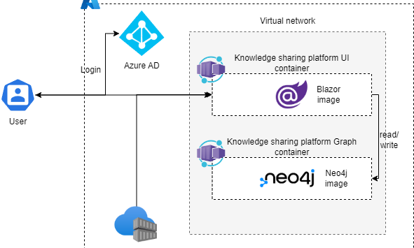
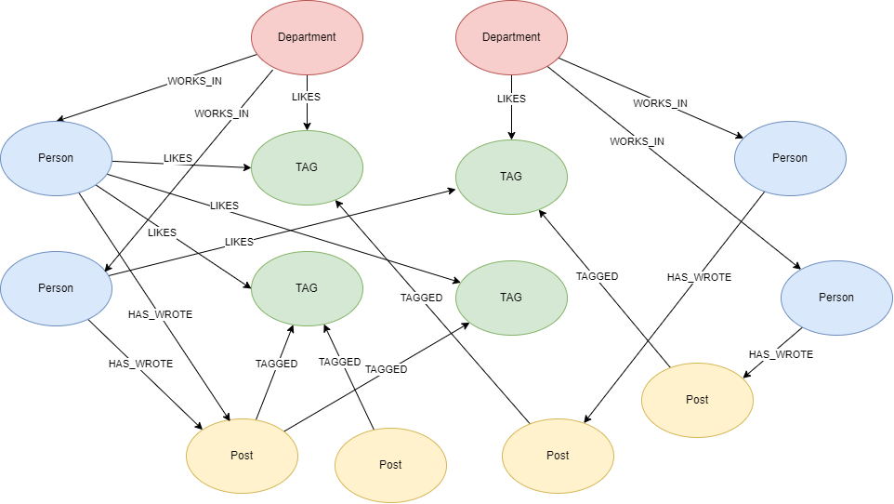
System diagrams
Designs that were created for the project –
Architecture Diagram
Using ACR for deployment
Using Container apps for hosting
.NET Blazor Web Application
Neo4j database
Use Case Diagrams
Graph Data Model Diagram
Class Diagrams
Domain Model Class Diagram
Service Oriented Class Diagram
Architecture Diagram
Graph Data Model Diagram
Notes:
Designs that were created for the project –
Architecture Diagram
Using ACR for deployment
Using Container apps for hosting
.NET Blazor Web Application
Neo4j database
Use Case Diagrams
Graph Data Model Diagram
Class Diagrams
Domain Model Class Diagram
Service Oriented Class Diagram

Slide 28
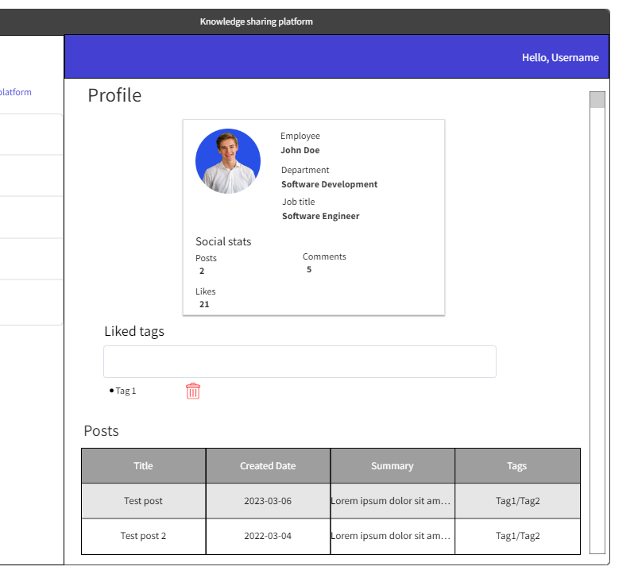
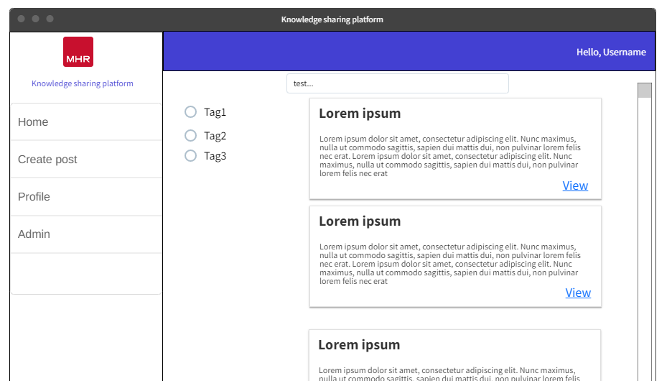
UX Designs
Wireframes were created for the UI.
These were then reviewed and had feedback from stakeholders in the project.
Prioritization of accessibility, simplicity, and inclusion
User-friendly interfaces and intuitive design principles
Integration of ethical principles for a responsible software development environment
Efficient and responsible user experience

Slide 29
Test plans
ID |  | Description
Test Type | Quantity or Quality test | Success criteria:
Number of attempts: |  | Comments:
List of equipment/ requirements
Setup instructions
Tester name
Test Date |  | Result
Test cases for the knowledge sharing platform
Covers all functional requirements in phase 1

Slide 30

Iterative development
Break down of each sprint with goals, outcomes and challenges

Slide 31
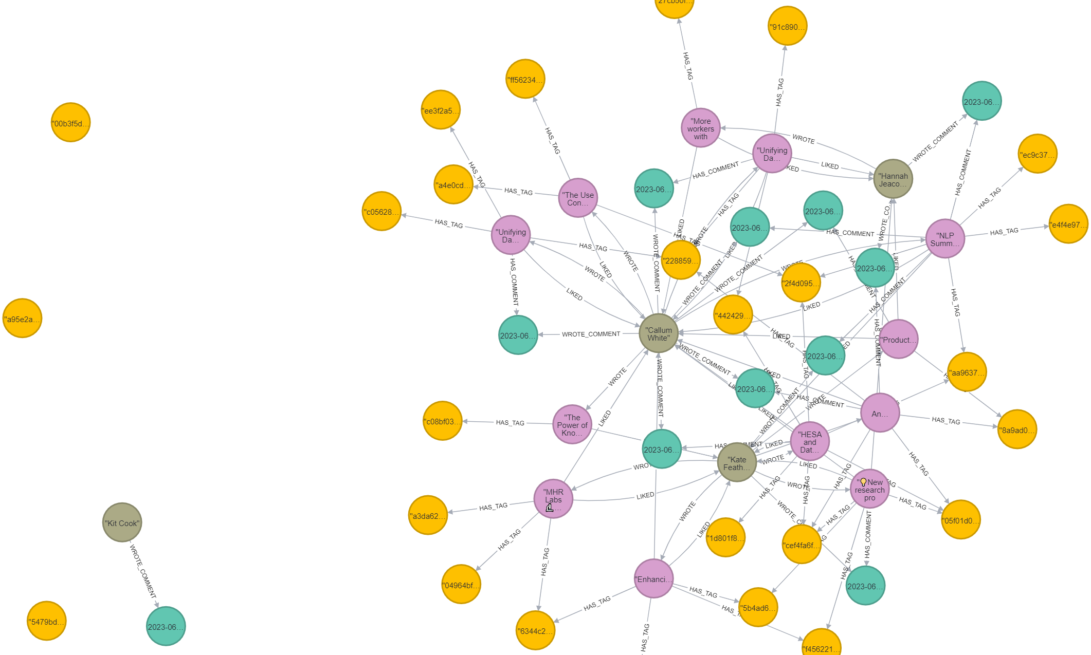
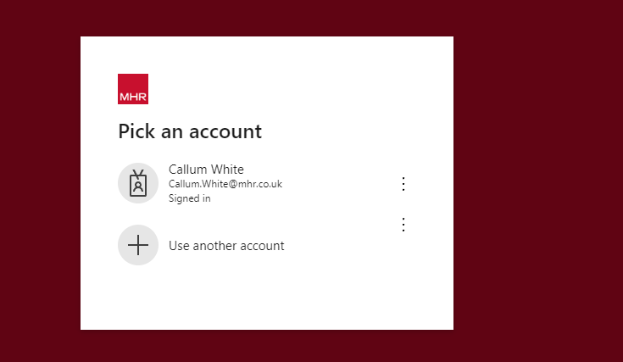
Sprint 1 Goals & Outcomes
Sprint Goal:
Enable Microsoft SSO login.
Build basic graph database models.
Task 1: Microsoft SSO Authentication:
Integrate SSO with .NET.
Configure authentication protocols.
Task 2: Graph Database Models:
Translate designs into code.
Use Neo4j graph database.
Task 3: Basic Landing Page:
Create user-friendly landing page.
Incorporate branding elements.
Neo4j database within Bloom
SSO (Single-sign on)

Slide 32
Sprint 1 Challenges
Authentication Integration Complexity:
Reading Microsoft documentation, setting up Azure app registration, and configuring the redirect URI for SSO implementation.
Graph Database Configuration:
Setting up Neo4j database connection, installing the .NET driver package, and ensuring proper data model implementation.
Landing Page Design and Optimization:
Designing an engaging landing page, ensuring responsiveness, and optimizing performance for the landing page.

Slide 33
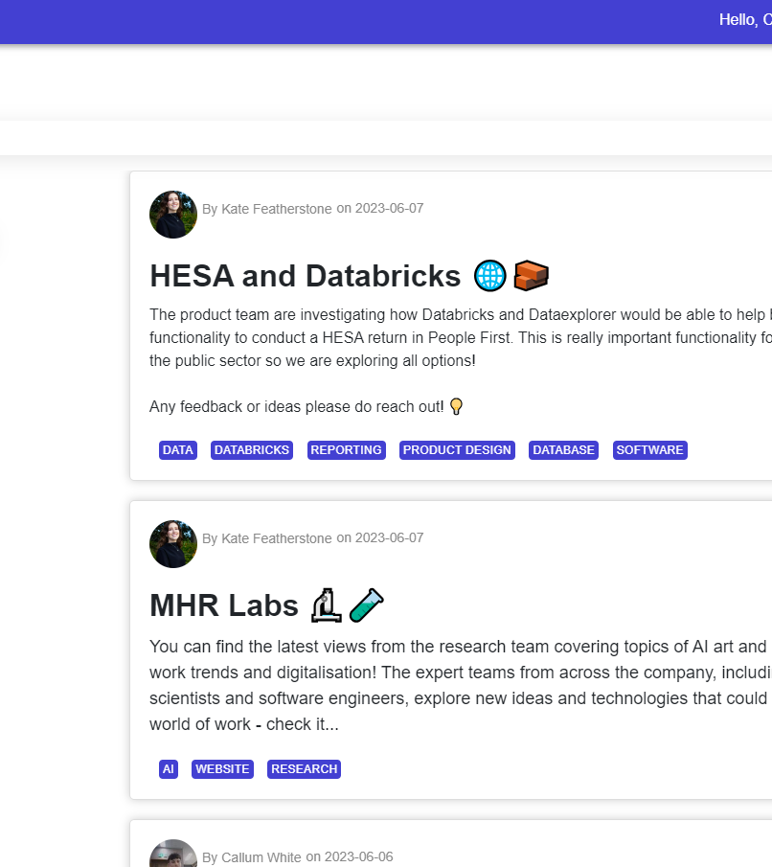
Sprint 2 Goals & Outcomes
Sprint Goal:
Enable users to create links, books, and free-form posts.
Display posts on the landing page with relevant tags.
Task 1: User Interface and Post Creation:
Design user-friendly interface for creating posts.
Gather necessary information for each post type.
Task 2: Tagging System and Search Functionality:
Implement tagging system for posts.
Allow users to add relevant tags and enable post filtering.
Task 3: Backend Storage and Display:
Store posts in the backend for retrieval.
Develop post service for creation and retrieval.
Integrate backend service to display posts on the landing page.

Slide 34
Sprint 2 Challenges
Creating Posts & Tags:
User-friendly interface implementation, form submission validation, and unique tagging system with dynamic input
Creating services:
Linking UI to backend service, ensuring data consistency and security, and considering user feedback for post editing and deletion.
Landing Page Design and Optimization:
Displaying relevant tagged posts, improving search and filter functionality based on user feedback.

Slide 35
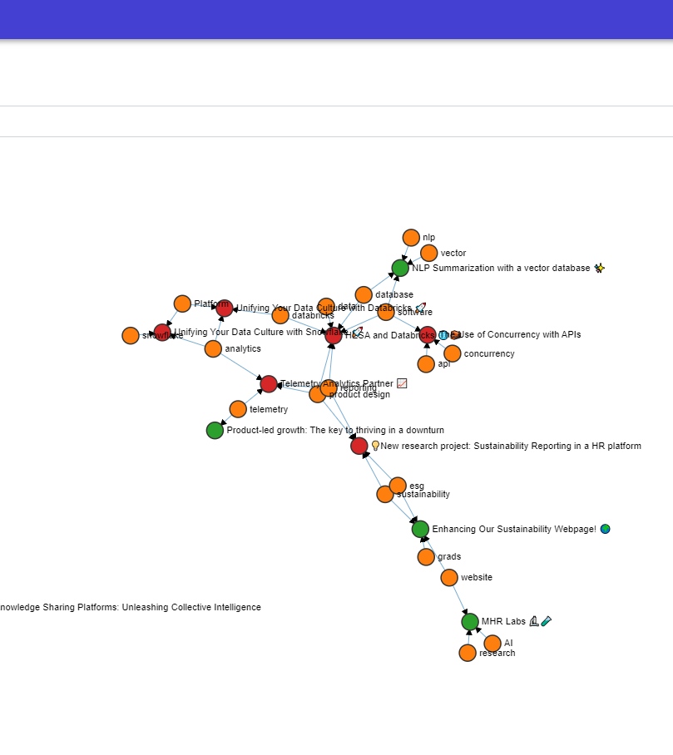
Sprint 3 Goals & Outcomes
Sprint Goal:
Enable users to manage their posts and liked tags
Visualize the graph relationships.
Task 1: User Post Management:
Create user interface for managing posts and liked tags.
Create functionality for viewing, editing, deleting, and updating posts.
Develop social analysis to display post, like, and comment statistics.
Task 2: Tagging System and Search Functionality:
Create a visually interactive graph visualization feature.
Display relationships between posts and tags.
Task 3 Admin Page:
Administrators to manage posts and tags.
Allow to grant or revoke admin access.
Notes:
User Post Management:
Design intuitive user interface for managing posts and liked tags.
Implement functionalities for viewing, editing, deleting, and updating posts.
Develop personalized social analysis to display post, like, and comment statistics.
Graph Visualization:
Create a visually appealing and interactive graph visualization feature.
Display relationships between posts and tags to identify trends and patterns.
Admin Page for Global Management:
Design an admin page for administrators to manage posts globally.
Provide tools for monitoring and removing inappropriate content.

Slide 36
Sprint 3 Challenges
Data security and user authorization:
Data security and user authorization
Intuitive and easy navigation:
User-friendly interface for post and tag management.
Understandable insights from data:
Visually appealing and informative graph visualization.
Notes:
Data security and user authorization: Ensure authorized access and modification.
Using Microsoft built in authorization tags to protect pages and actions
User-friendly interface for post and tag management: Intuitive and easy navigation.
Using Radzen framework
Visually appealing and informative graph visualization: Understandable insights from data.
The use of D3

Slide 37
Test driven development
Understand requirements and write test case.
Write test from test case and run test so it fails.
Write implementation of functionality and rerun to test to pass.
Refactor code.
Repeat process for any changing behaviour of functionality

Slide 38
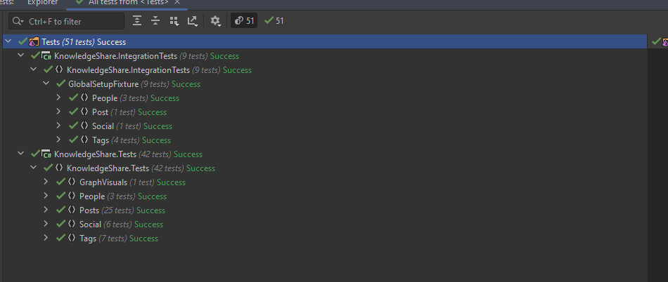
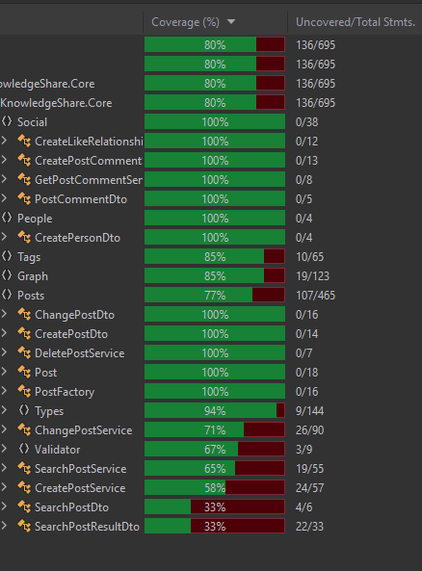
Test driven development Unit & Integration test results

Slide 39
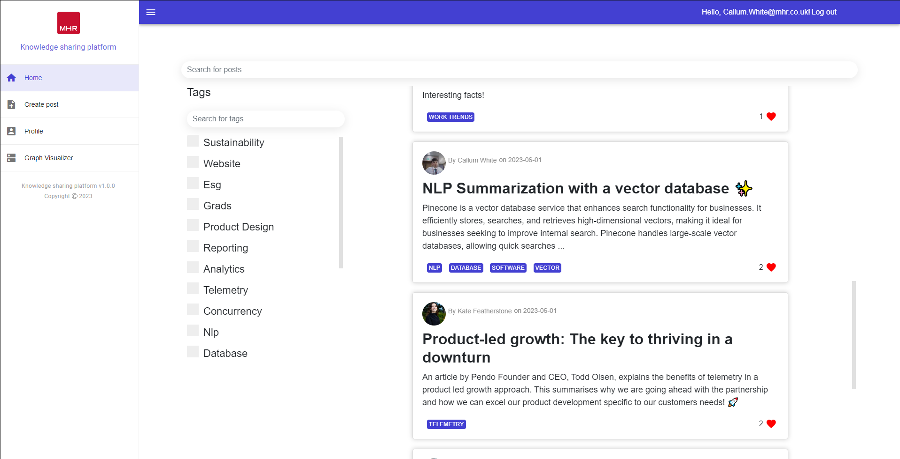
Live Demo of Knowledge sharing platform
Kate will be helping with the Demo

Slide 40
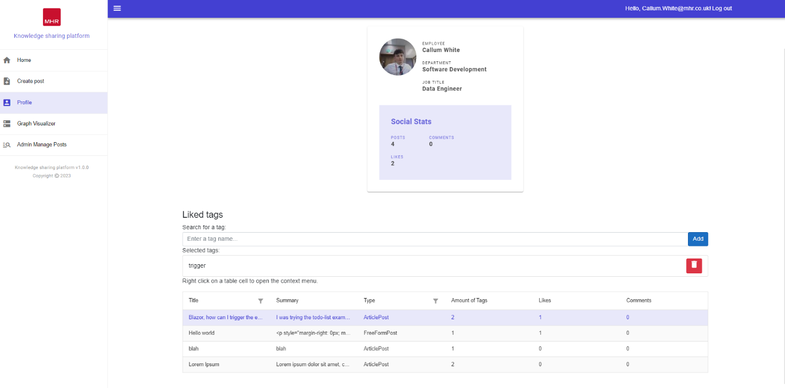
UI Feedback
User experience (UX) feedback must be incorporated into the knowledge sharing platform's iterative development process to improve the platform's usability and aesthetic appeal.
Notes:
User experience (UX) feedback must be incorporated into the knowledge sharing platform's iterative development process to improve the platform's usability and aesthetic appeal. In this review, a UX specialist within in the business offers insightful commentary on the platform's various pages' CSS styling. Their suggestions centre on maximising screen space, achieving visual harmony, upholding consistency, and enhancing user experience overall.

Slide 41
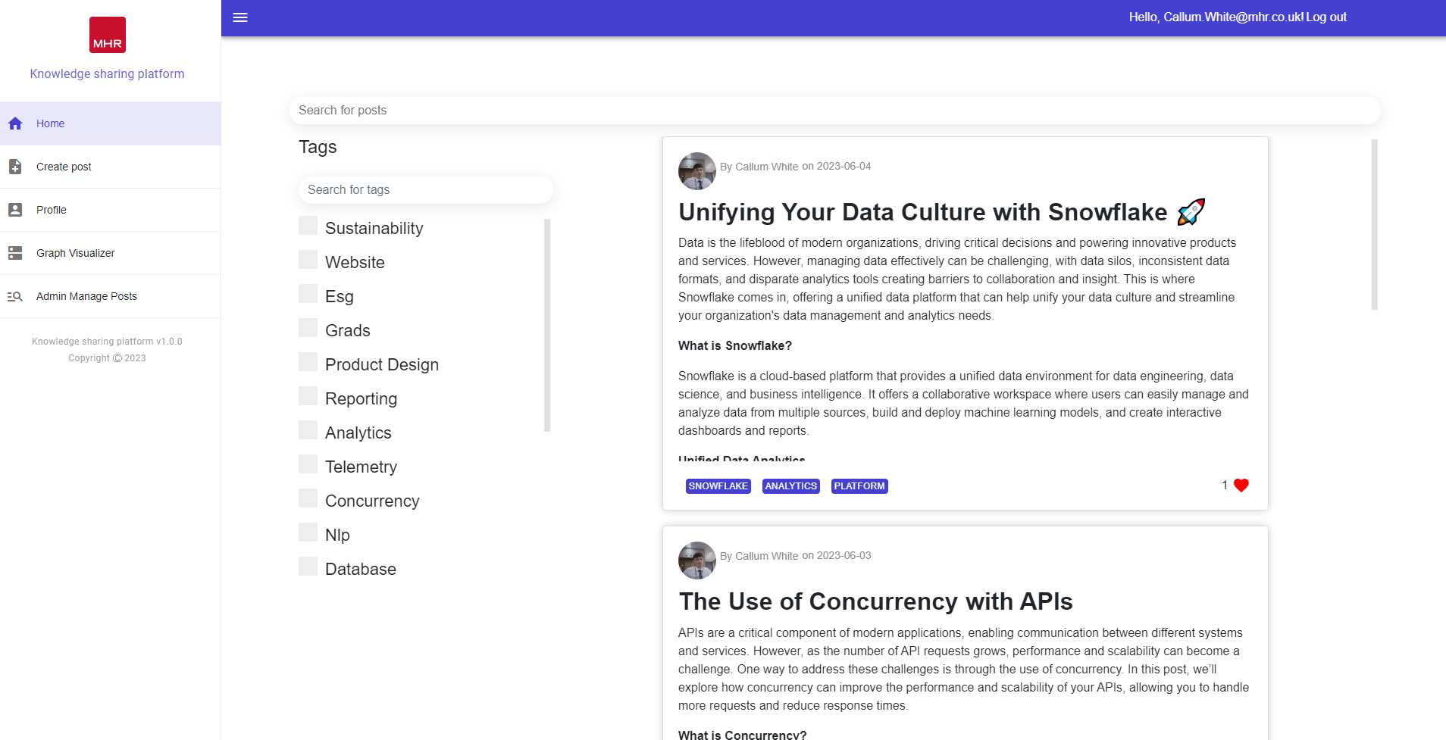
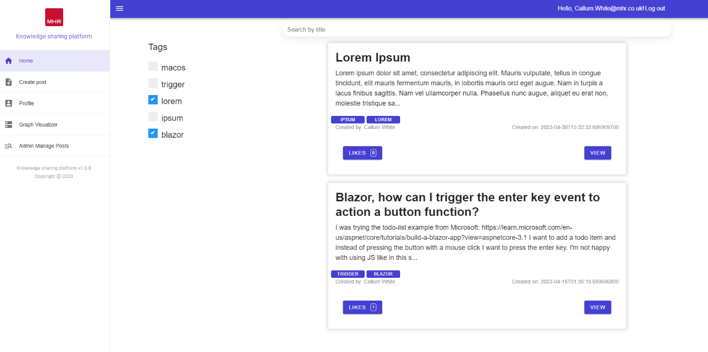
Discovery page
Notes:
Padding Reduction at the Bottom of Cards: To optimize screen real estate and achieve a more visually balanced layout, it is recommended to decrease the padding between the content of the cards and the bottom edge. This adjustment will create a more compact design while maintaining the necessary breathing space.
Background Removal and Lowercasing of "Likes": To maintain a consistent and modern typographic style, our UX expert suggests removing any background element behind the likes count on the cards. Additionally, they recommend using lowercase letters for the word "likes." These changes will contribute to a cleaner and more streamlined appearance.
Alignment of Likes with Info Detail: To enhance the visual hierarchy and overall alignment, aligning the likes count with the accompanying information details on the cards is advised. This adjustment will result in a more organized and visually pleasing layout, improving the overall user experience.
Removal of "View" Button for Post Access: To simplify the user interface and streamline the navigation, our UX expert proposes removing the "View" button that allows users to access the full post from the discovery page. Instead, it is suggested to make the entire card clickable, enabling users to navigate to the post by clicking anywhere on the card.
Use of Light Grey Colours for Tags: For an aesthetically pleasing design and reduced visual distractions, our colleague suggests utilizing light grey colours for the tags on the discovery page, replacing the current blue. This adjustment will create a more subdued and harmonious colour palette, allowing the primary content to stand out effectively.

Slide 42
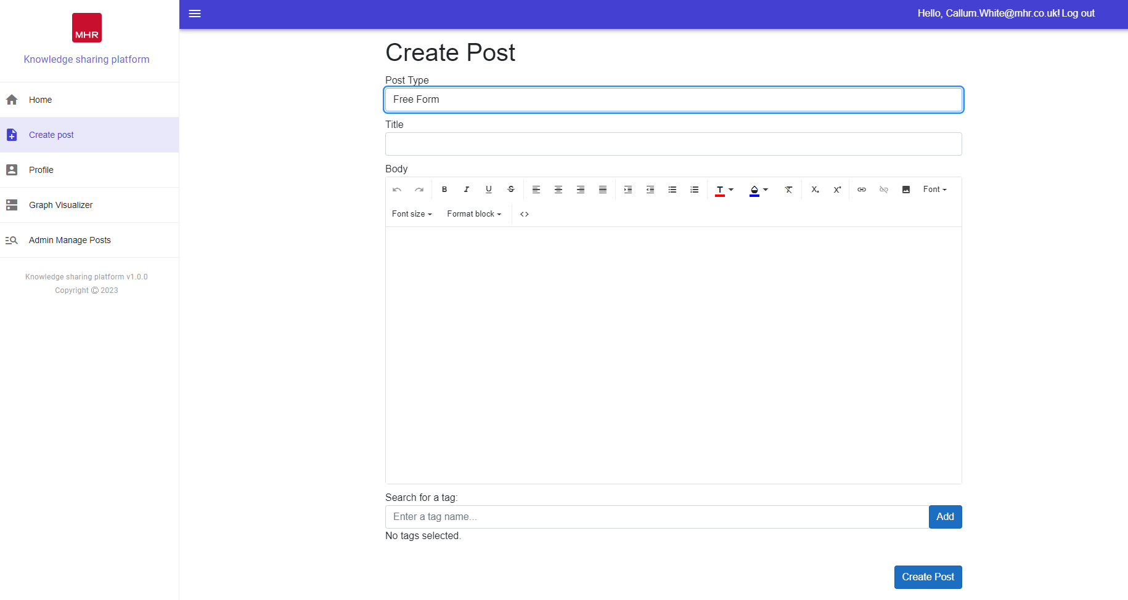
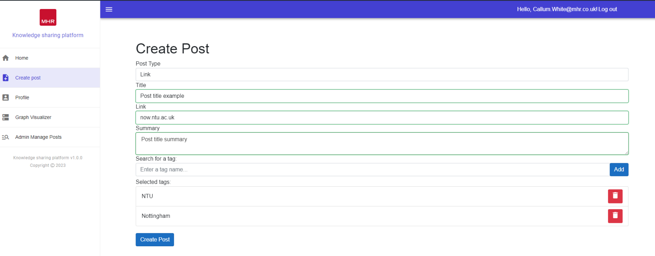
Create post page
Notes:
Padding Reduction at the Bottom of Cards: To optimize screen real estate and achieve a more visually balanced layout, it is recommended to decrease the padding between the content of the cards and the bottom edge. This adjustment will create a more compact design while maintaining the necessary breathing space.
Background Removal and Lowercasing of "Likes": To maintain a consistent and modern typographic style, our UX expert suggests removing any background element behind the likes count on the cards. Additionally, they recommend using lowercase letters for the word "likes." These changes will contribute to a cleaner and more streamlined appearance.
Alignment of Likes with Info Detail: To enhance the visual hierarchy and overall alignment, aligning the likes count with the accompanying information details on the cards is advised. This adjustment will result in a more organized and visually pleasing layout, improving the overall user experience.
Removal of "View" Button for Post Access: To simplify the user interface and streamline the navigation, our UX expert proposes removing the "View" button that allows users to access the full post from the discovery page. Instead, it is suggested to make the entire card clickable, enabling users to navigate to the post by clicking anywhere on the card.
Use of Light Grey Colours for Tags: For an aesthetically pleasing design and reduced visual distractions, our colleague suggests utilizing light grey colours for the tags on the discovery page, replacing the current blue. This adjustment will create a more subdued and harmonious colour palette, allowing the primary content to stand out effectively.

Slide 43
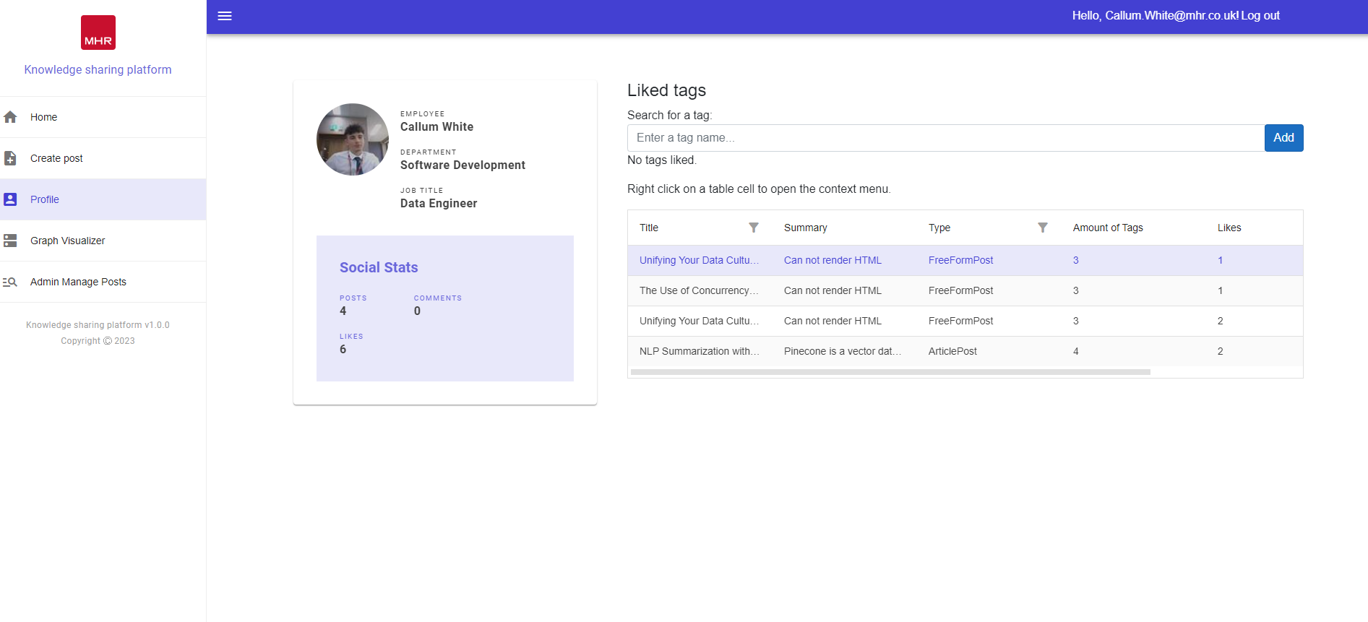
Profile page
Notes:
Padding Reduction at the Bottom of Cards: To optimize screen real estate and achieve a more visually balanced layout, it is recommended to decrease the padding between the content of the cards and the bottom edge. This adjustment will create a more compact design while maintaining the necessary breathing space.
Background Removal and Lowercasing of "Likes": To maintain a consistent and modern typographic style, our UX expert suggests removing any background element behind the likes count on the cards. Additionally, they recommend using lowercase letters for the word "likes." These changes will contribute to a cleaner and more streamlined appearance.
Alignment of Likes with Info Detail: To enhance the visual hierarchy and overall alignment, aligning the likes count with the accompanying information details on the cards is advised. This adjustment will result in a more organized and visually pleasing layout, improving the overall user experience.
Removal of "View" Button for Post Access: To simplify the user interface and streamline the navigation, our UX expert proposes removing the "View" button that allows users to access the full post from the discovery page. Instead, it is suggested to make the entire card clickable, enabling users to navigate to the post by clicking anywhere on the card.
Use of Light Grey Colours for Tags: For an aesthetically pleasing design and reduced visual distractions, our colleague suggests utilizing light grey colours for the tags on the discovery page, replacing the current blue. This adjustment will create a more subdued and harmonious colour palette, allowing the primary content to stand out effectively.

Slide 44
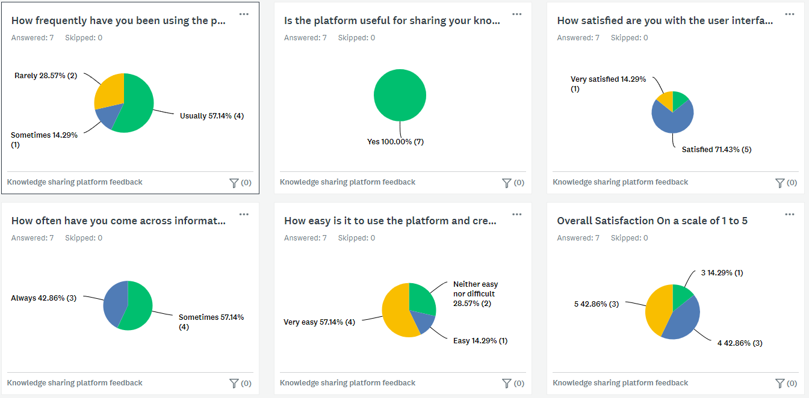
Knowledge sharing feedback Against success criteria
Notes:
Increased User Engagement
Frequent platform usage (57.14%)
High satisfaction with user interface (71.43% satisfied, 14.29% very satisfied)
Successful implementation of user authentication, profile management, and content creation
Improved Knowledge Sharing
Users found the platform useful for sharing knowledge
Successful implementation of content creation features and tagging/searching capabilities
Positive feedback on platform's ease of use (57.14% very easy, 14.29% easy)
Reduced Silos
Effective cross-departmental collaboration
Successful implementation of social features (liking, commenting) and tags
Positive feedback on encountering information shared by other departments
Efficient Administration
Positive feedback on platform's ease of use and satisfaction
Successful implementation of admin dashboard for user account management and content moderation
Inclusion of analytics and reporting features
Effective Recommendations
Users found platform recommendations useful
Successful implementation of recommended post feed
Positive feedback on engagement with recommended posts
Secure and Reliable
No concerns raised regarding security breaches or data leaks
Successful implementation of user authentication and authorization
Positive feedback on platform's security and reliability
Scalable Solution
Positive feedback on frequent usage and satisfaction ratings
Successful integration with existing systems and workflows
Ability to handle increasing user, post, and interaction volumes

Slide 45
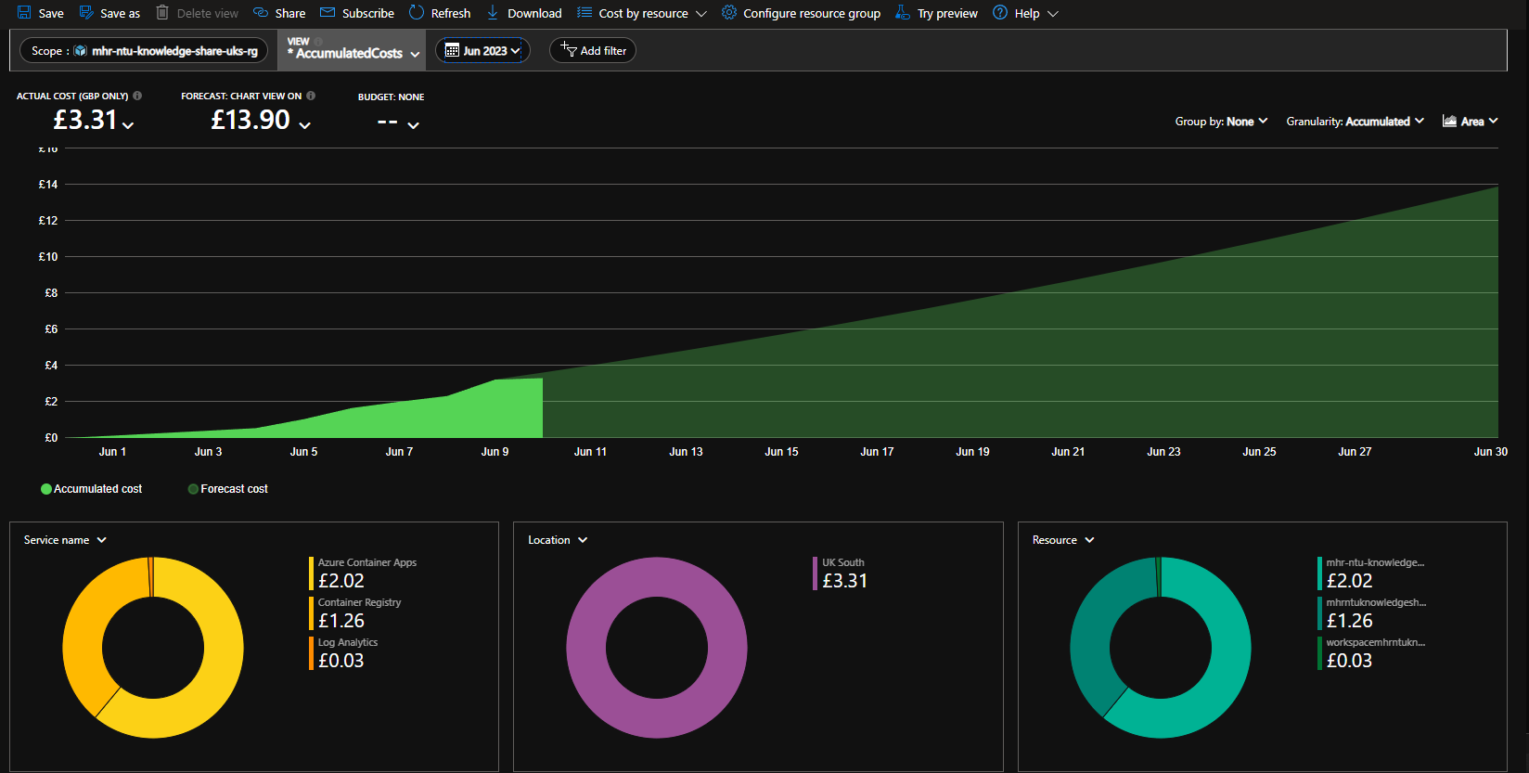
Hosting Cost Analysis
Azure Cost Analysis of Knowledge Sharing Platform
Forecasted hosting cost: £13.90
Cost growth varies with user numbers, logarithmic.
Leveraging Kubernetes for resource optimisation and scaling.
Comparison with Nuclino Platform:
Nuclino platform: £40,800.00
Demonstrates superior affordability of internal platform.

Slide 46
Future work Future Functional Requirements
Notification System for Updates and Activity:
Real-time notifications via email, push, or in-app alerts.
Enhance user engagement and keep users updated.
User-Following Functionality:
Enable users to follow others for community and connection.
Stay connected with posts from followed users.
Integration with External Social Media Platforms:
Share platform content to external social media.
Extend content reach and encourage broader discussions

Slide 47
Future work Potential Improvements
Abstract Logical Tier into an API
Separate web application's logical tier into a REST API.
Improve codebase management, scalability, and maintenance.
Implement Playwright for Automated UI Testing
Utilize Playwright for robust UI testing.
Identify UI issues and validate user interactions
Enhanced Analytics Capabilities
Provide detailed insights into user behaviour and content performance.
Use data to refine platform effectiveness.

Slide 48
Project conclusion
Project achieved significant success in knowledge sharing and user engagement
Continuous improvement needed to break down departmental silos and enhance content moderation
Robust security measures necessary to protect against unauthorized access and data threats
Incorporate more non-functional test plans and automated UI tests for stability and reliability
Notes:
Project achieved significant success in knowledge sharing and user engagement
Continuous improvement needed to break down departmental silos and enhance content moderation
Robust security measures necessary to protect against unauthorized access and data threats
Incorporate more non-functional test plans and automated UI tests for stability and reliability

Slide 49
Positive impact on knowledge sharing and collaboration
Strengthened teamwork, accelerated innovation, and continuous learning culture
Transforming collaboration and knowledge sharing. Unlocking new possibilities for success together
Notes:
Express gratitude to the team and stakeholders: Thank the development team, project sponsors, and end-users for their contributions and support.
Emphasize the positive impact on knowledge sharing and collaboration: Strengthened teamwork, accelerated innovation, and continuous learning culture.
Closing Statement: "With our knowledge sharing platform, we have transformed how we collaborate and share knowledge. Let's continue to leverage this powerful tool to unlock new possibilities and drive success together."

Slide 50
References
Innovation training: Innovation workshops: Innovation speaker (2021) Innovation Training | Design Thinking Workshops. Available at: https://www.innovationtraining.org/ (Accessed: June 1, 2023).
Author, G. (2022) Marketing tools you can use, Influencer Marketing Hub. Available at: https://influencermarketinghub.com/support-ukraine-marketing-tools/ (Accessed: June 2, 2023).

Slide 51

Thank you Q&A
Notes:
I have shared with you today the work that has gone into this project on the Knowledge Sharing Platform and now I am going to hand over to you for any final questions

